Slide 1

Data Structures and Algorithms I.
University of Szeged – Robert Nagy
2025/26. Autumn Semester

Slide 2
Introduction to the course

Slide 3
Requirements
2 Written Assignments (50 + 50 points)
Potential extra points for class work (up to 10)

Slide 4

Required Minimum
15 points per W.A.
50/100 in total

Slide 5

Attendance is NOT mandatory!

Slide 6

About the teacher
3rd year student (Undergraduate)
Software Developer Intern (7+ months of exp. (as of September 2025))

Slide 7

I don’t know everything!
…But maybe you will learn something!

Slide 8

Motivation
Solving real world problems with computers

Slide 9
Foundations
What is an algorithm?

Slide 10
Cost of computation
Time?
Space?

Slide 11
Model of computation
RAM Model (Random Access Machine)

Slide 12
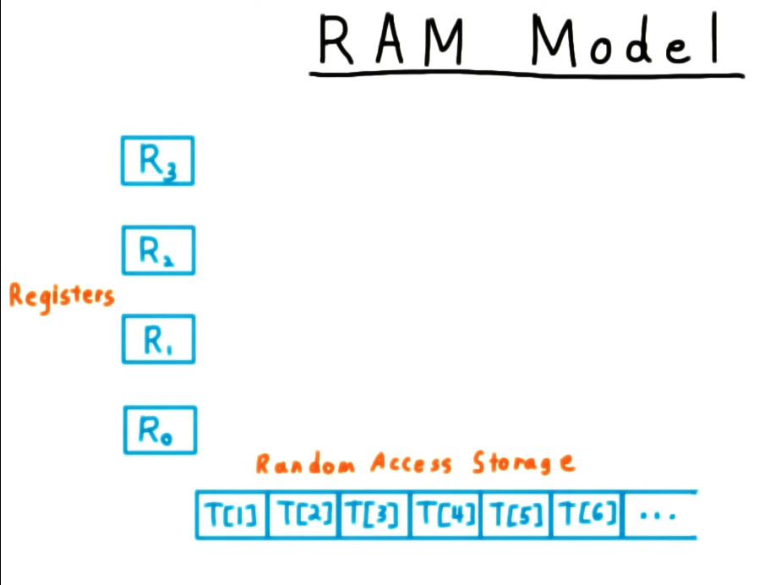
Source: https://www.youtube.com/watch?v=wkBjD0Fvl6U

Slide 13
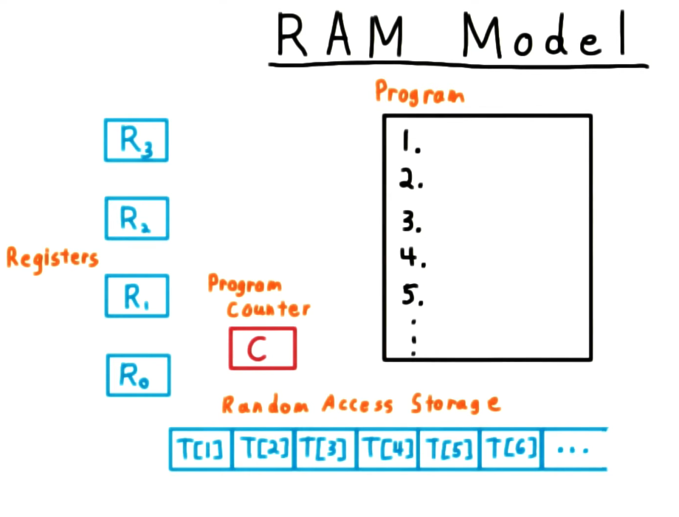
Source: https://www.youtube.com/watch?v=wkBjD0Fvl6U

Slide 14
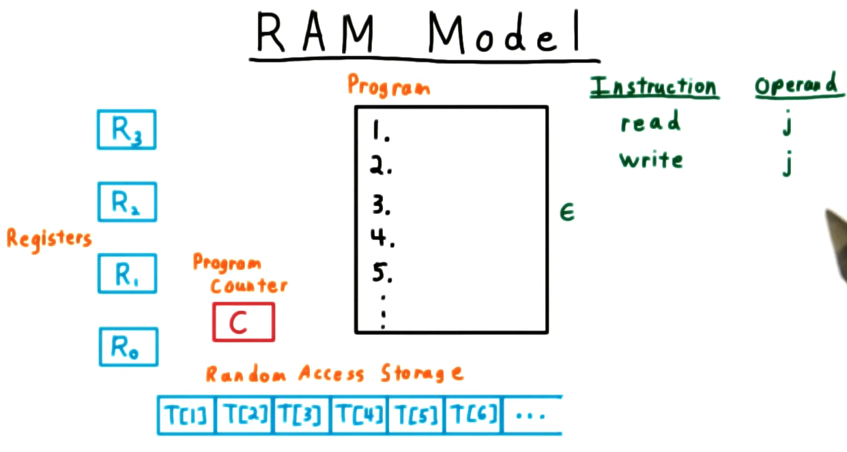
Source: https://www.youtube.com/watch?v=wkBjD0Fvl6U

Slide 15

Basic operations
Constant time!

Slide 16
Arithmetic (+, -, *, /, %...)
Data movement (Load, Store…)
Control (Method call, conditional jump, etc…)

Slide 17
Example:
Insertion Sort

Slide 18
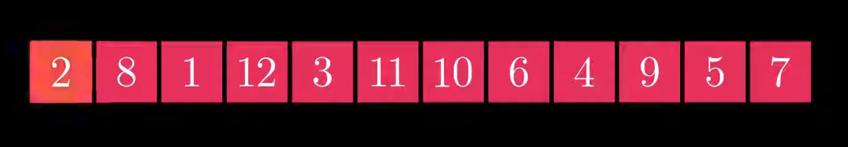
Source: https://www.youtube.com/watch?v=Q1JdRUh1_98

Slide 19
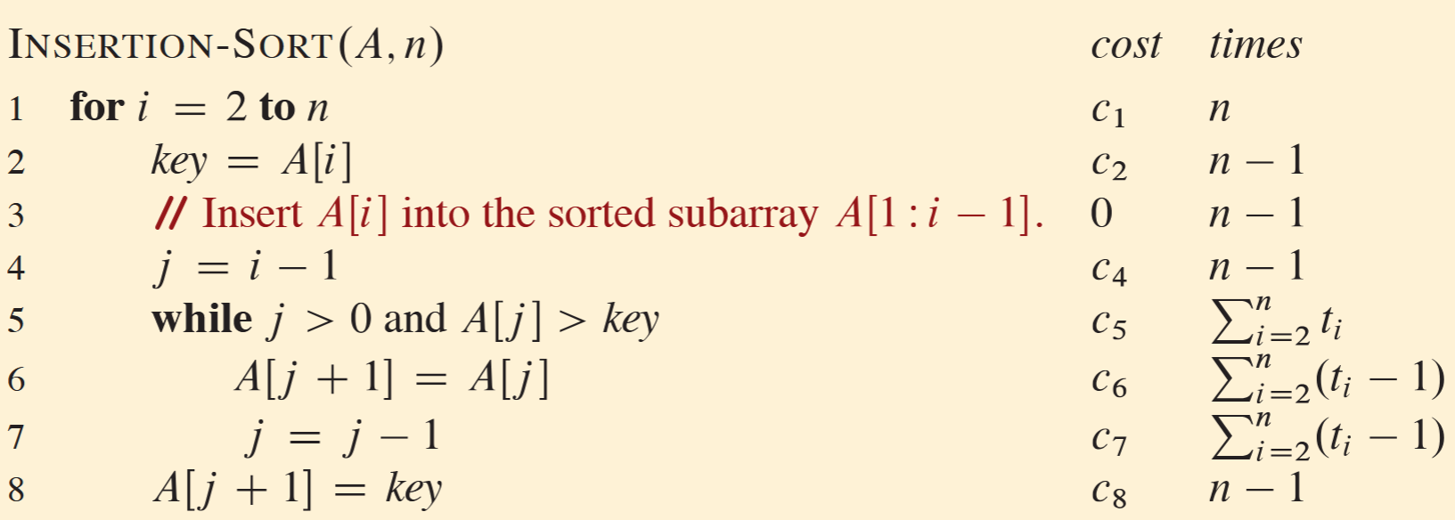
Insertion Sort - Pseudocode

Slide 20
Insertion sort - Pseudocode

Slide 21
Insertion sort - Pseudocode

Slide 22
Insertion sort - Pseudocode

Slide 23
Insertion sort - Pseudocode

Slide 24
Can we formalize the “time it takes to solve a problem” as a function of the “size of the input”?

Slide 25
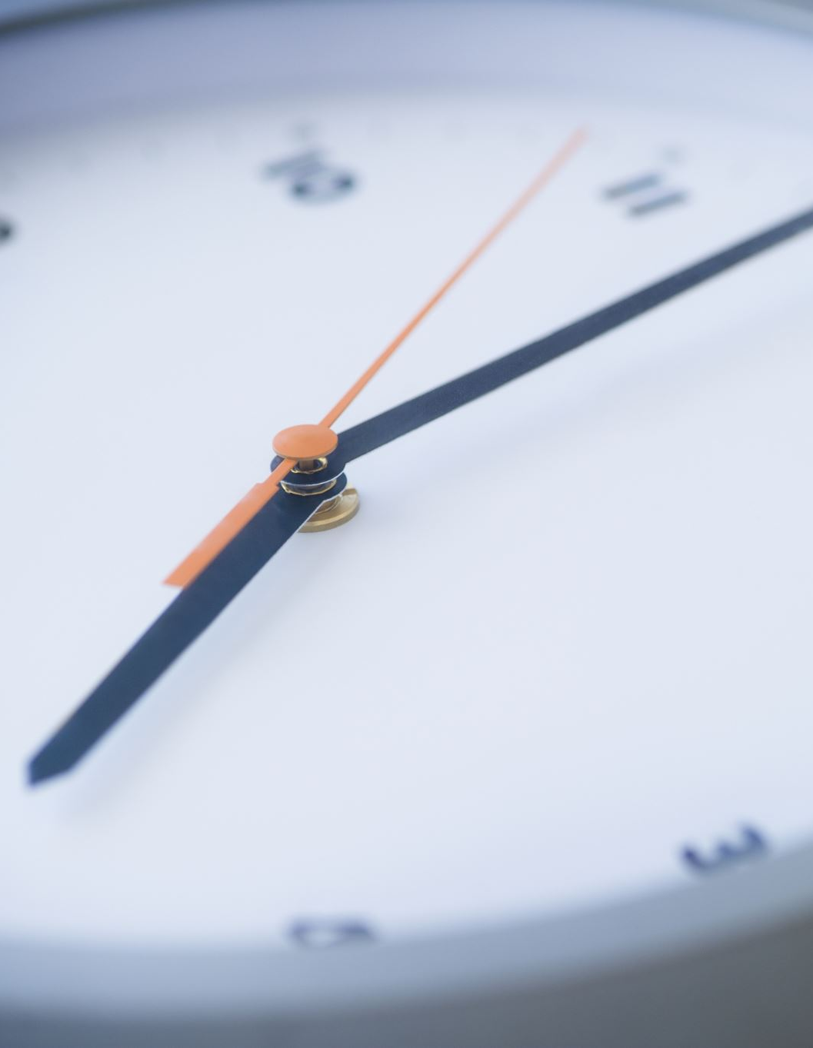
The total time
Let the total time our algorithm consumes be T(n)

Slide 26
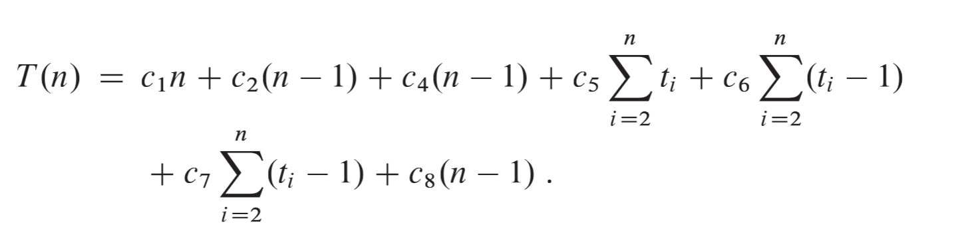

Slide 29
This looks complicated…

Slide 30
Let’s simplify things!

Slide 31
edge cases
Worst case
Average case
Best case

Slide 32
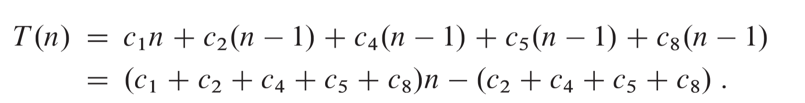
Best case

Slide 33
Best case
The input array is already sorted. Therefore, $t_{i}=1$

Slide 34

Best case
$$=a n+b$$

Slide 35
Best case
$$=a n+b$$
This is a Linear Function of n.

Slide 36
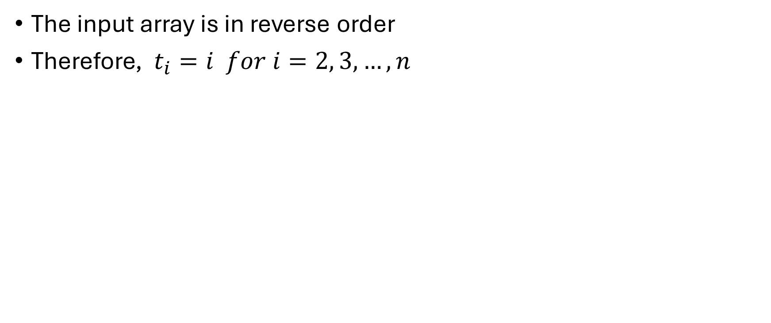
Worst case
The input array is in reverse order
Therefore, $t_{i}=i for i=2, 3,…,n$

Slide 37
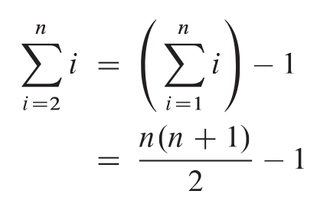
Worst case

Slide 38
Worst case

Slide 39
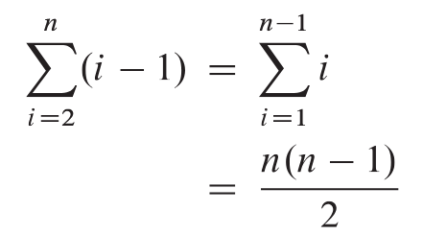
Worst case

Slide 40
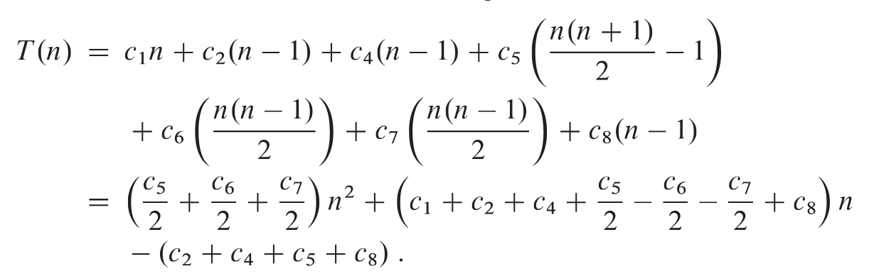
Worst case

Slide 41
Worst case

Slide 42
Worst case
$$=an^{2}+bn+c$$

Slide 43
The worst case is a quadratic function of n.
$$T(n)=an^{2}+bn+c$$

Slide 44

Let’s get even deeper into formalism!

Slide 45
Time complexity
Upper bound - O
Lower bound - Ω
Tight bound - Θ

Slide 46
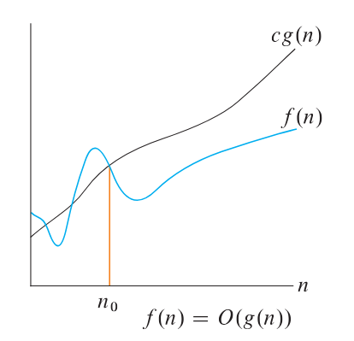

Slide 47
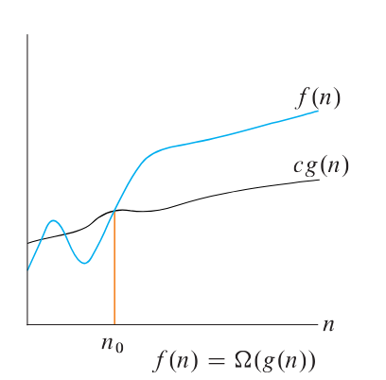

Slide 48
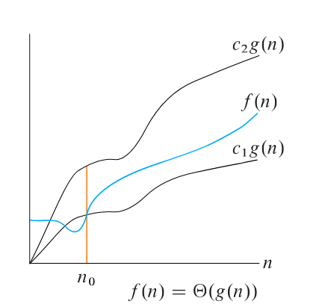

Slide 49
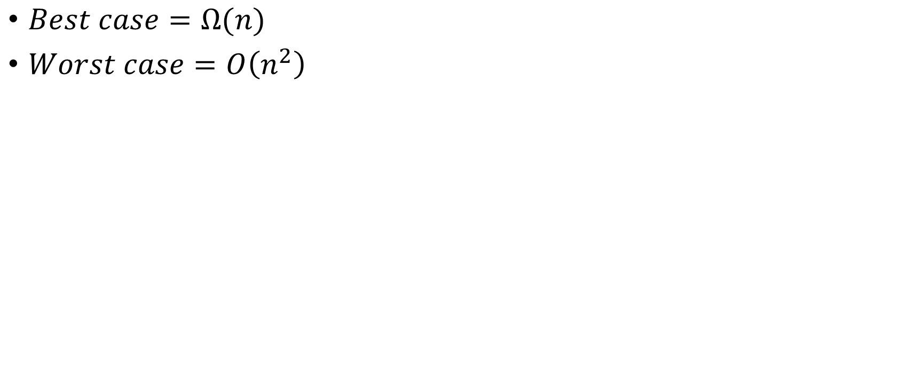
So, we can say:
$Best case=Ω(n)$
$Worst case=O\left(n^{2}\right)$

Slide 50
So, we can say:
$Best case=Ω(n)$
$Worst case=O\left(n^{2}\right)$
…What about the average case?

Slide 51
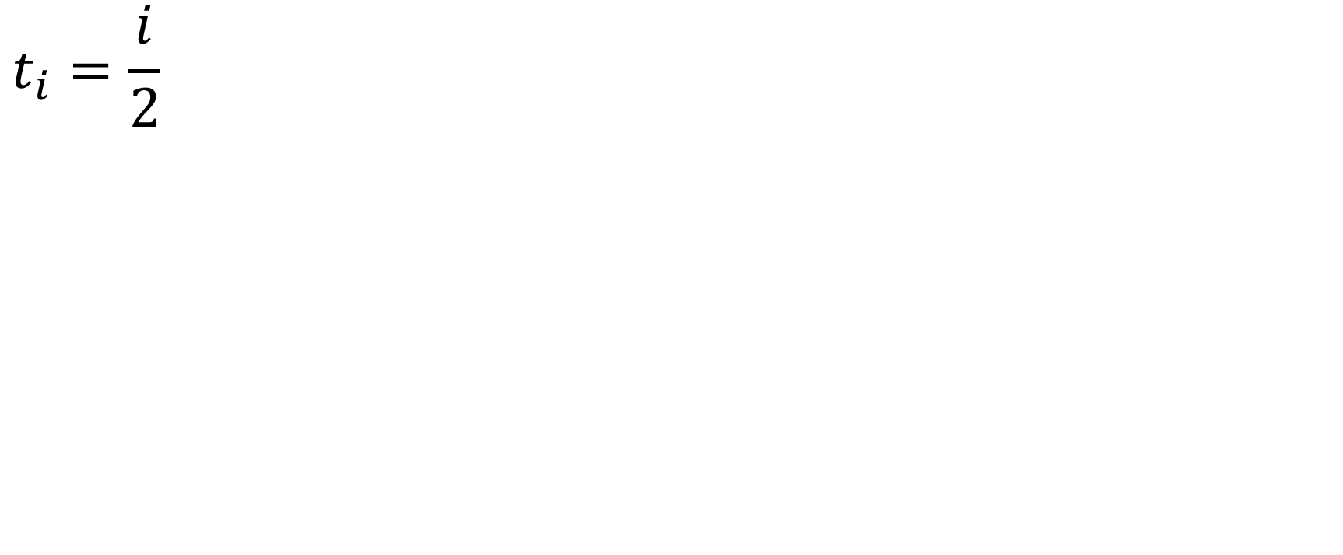
On average
$$t_{i}=\frac{i}{2}$$

Slide 52
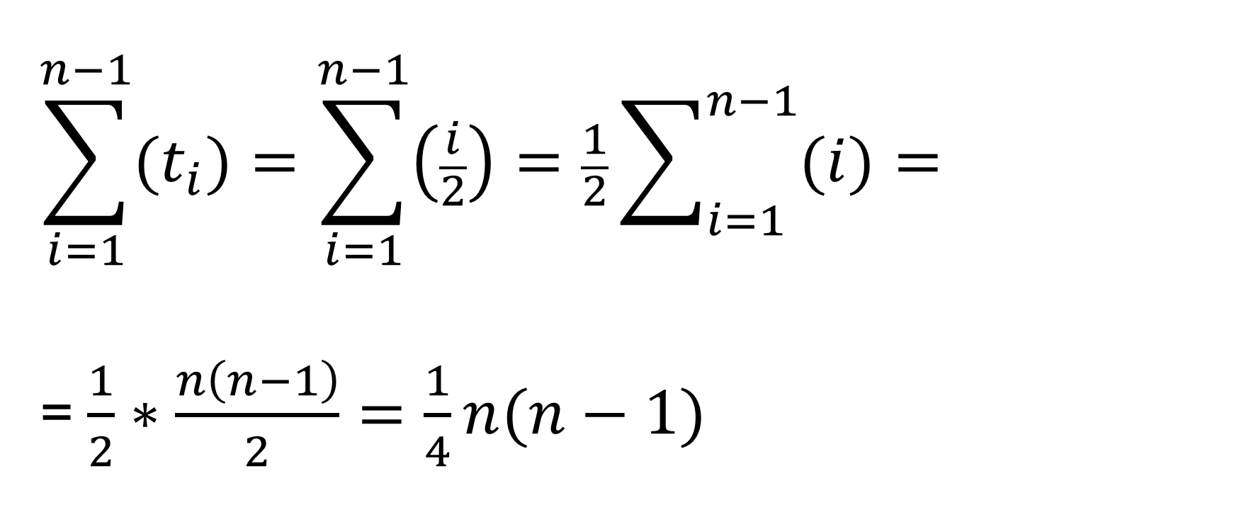
On average
$$\sum_{i=1}^{n−1}{(t_{i})}=\sum_{i=1}^{n−1}{\left(\frac{i}{2}\right)}=\frac{1}{2}\sum_{i=1}^{n−1}{(i)}=$$
= $\frac{1}{2}∗\frac{n\left(n−1\right)}{2}=\frac{1}{4}n(n−1)$

Slide 53
The average case is often roughly as bad as the worst case.

Slide 54
What really matters – The Rate of growth

Slide 55
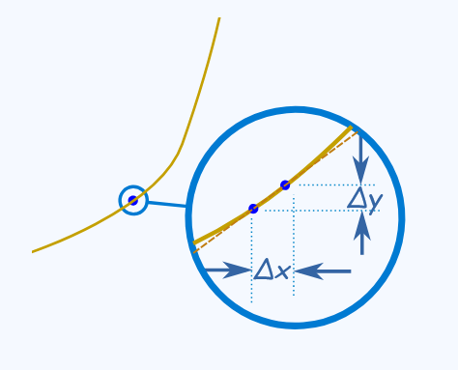

Sounds familiar?
$$y=f(x)$$
https://www.mathsisfun.com/definitions/differentiation.html

Slide 56
Exercises

Slide 57
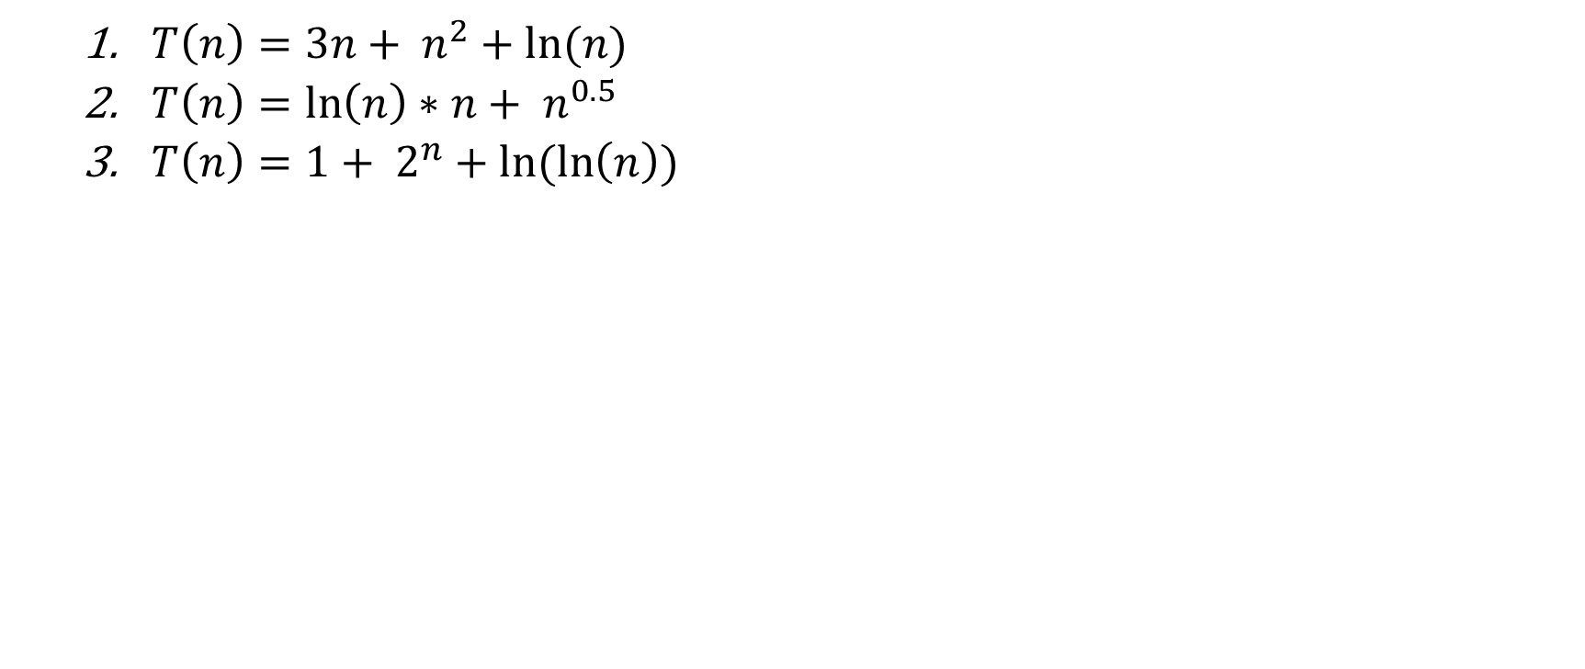
Determine the upper bound for the following functions:
  $T\left(n\right)=3n+ n^{2}+ln⁡(n)$
  $T\left(n\right)=\ln\left(n\right)∗n+ n^{0.5}$
  $T\left(n\right)=1+ 2^{n}+ln⁡(\ln\left(n\right))$

Slide 58
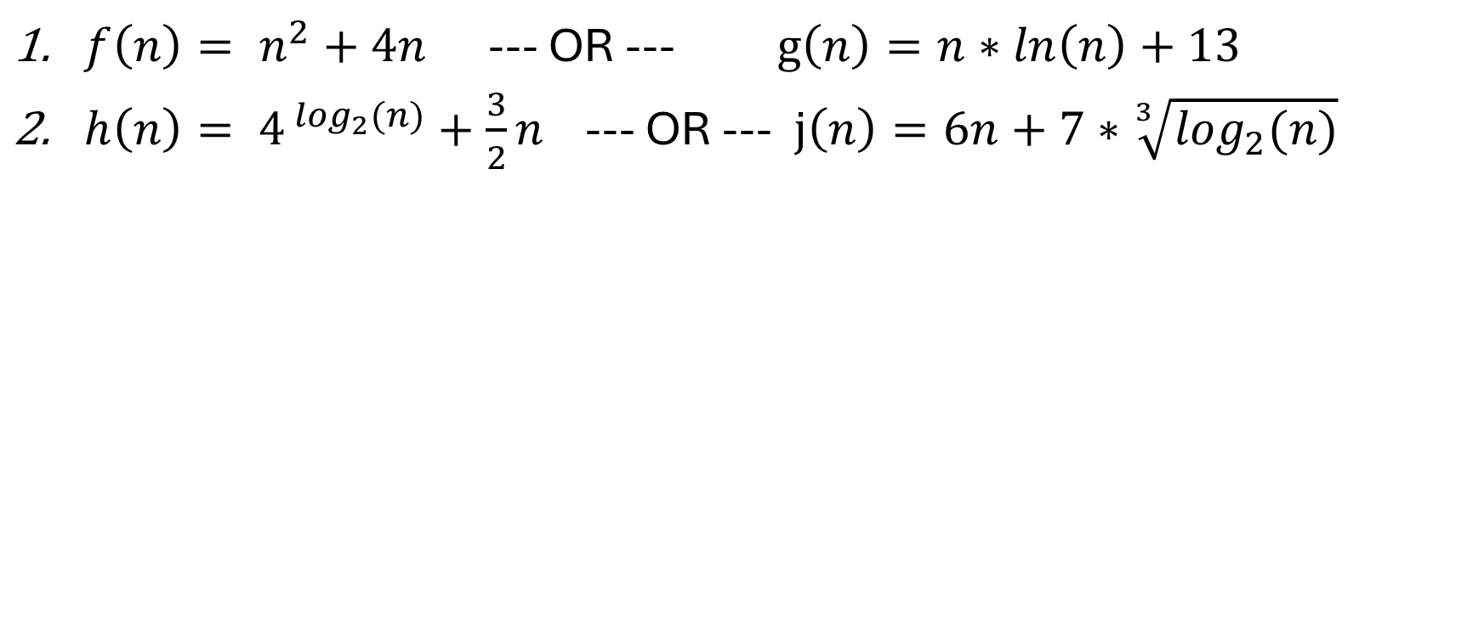
Determine which function grows faster
$f\left(n\right)= n^{2}+4n$ --- OR --- $g\left(n\right)=n∗ln\left(n\right)+13$
$h\left(n\right)= 4^{⁡\log_{2}(n)}+\frac{3}{2}n$ --- OR --- $j\left(n\right)=6n+7∗\sqrt[3]{\log_{2}(n)}$

Slide 59
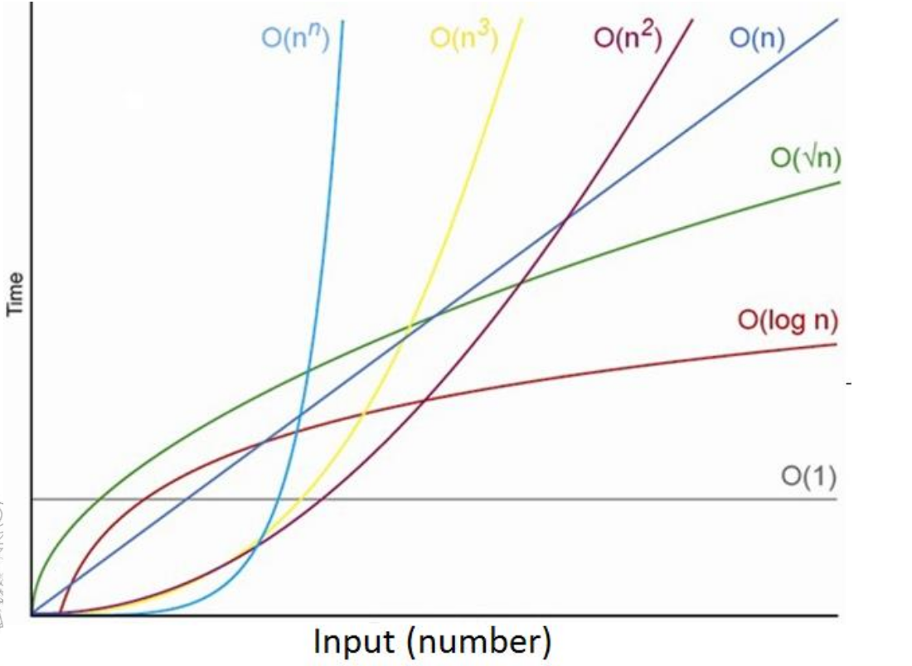

Slide 60
